Slide 1
INTERNET OF THINGS
NAME:FATIMA NUMRAH
ROLL NO:056

Slide 2
INTERNET OF THINGS (IoT)
What does IoT means?
IoT(internet of thing) refers to a network of physical devices connected to the internet that can collect, send, and receive data without human involvement.
For example:
Security camera
Smart cars
Health monitoring device
What is IoT role in ICT?
IoT is studied as a technology that connects everyday devices through the internet to make them smart, automated, and remotely controlled.
IT HAVE FOUR KEY STAGES

Slide 3
IoT(INTERNET OF THINGS)
FOUR KEY STAGES
SENSORS/DEVICES(DATA COLLECTION)
It collect data from the environment
For example:
Smart lights (in home)
Automatic door
Security system
CONECTIVITY(DATA TRANSMISSION)
The data collected by sensors is sent to cloud or
Network using Wi-Fi, Bluetooth , Ethernet
DATA PROCESSING(CLOUD/SERVER ANALYSES)
The cloud or sever processes the received data and makes decision
For example:
Mention sensor detect motion
Temperature sensor
USER INTERFACE(ACTION(OUTPUT TO USER))
Were the process data is shown to the user in easy to understand way
For example:
Room temperature on mobile phone
Fitness tracker to display your heart rate

Slide 4
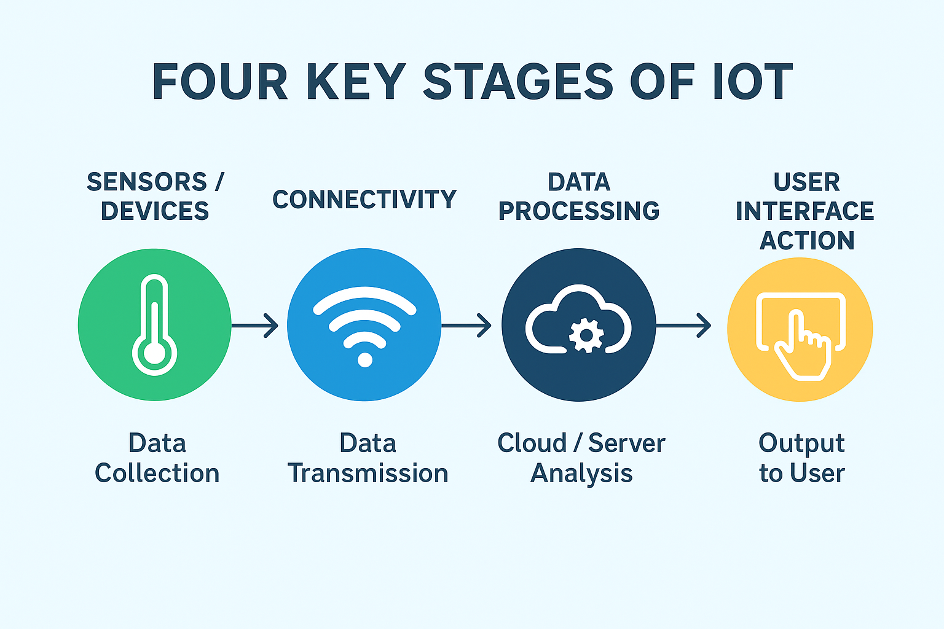
IoT(INTERNET OF THINGS)

Slide 5
APPLICATIONS OF IoT
SMART HOMES
security system
lighting
smart door
HEALTH CARE
smart watches and fitness band
smart medical device
remote patient monitoring
TRANSPOTATION
GPS tracking
smart traffic control
Self-driving cars
Industry / Manufacturing (IIoT)
Machine monitoring
Predictive maintenance
Smart factories
Smart Cities
Smart streetlights
Waste management
Pollution monitoring
Smart parking systems
“It is also use in agriculture and education”

Slide 6
Conclusion: the Internet of Things (IoT) is a modern technology where devices collect data from the environment using sensors and send it through connectivity networks like Wi-Fi or Bluetooth. This data is then processed in the cloud to make decisions, and the results are shown to the user through a user interface such as a mobile app or dashboard. IoT is widely used in smart homes, healthcare, agriculture, transportation, industries, and smart cities. Overall, IoT makes everyday devices smart, automated, and more efficient, improving comfort, safety, and productivity in daily life.

Slide 7
Thank You ☺

